Slide 1
RWD Case Study
Redesign Federal Website

Slide 2
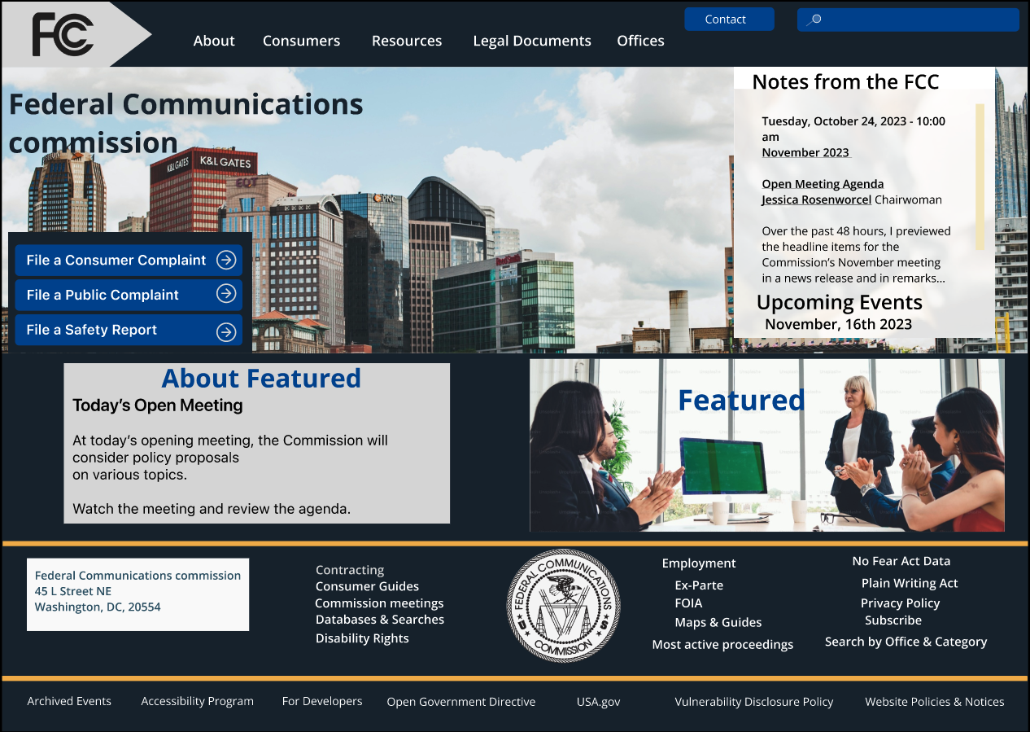
PROJECT OVERVIEW
THE PROBLEM: The user is attempting to file a complaint on the website due to extended wait times on the listed phone number.
THE SOLUTION: Redesign the website to make it user-friendly and easy to navigate, allowing users to quickly find necessary information.
MY ROLE: User Experience & Interface Design, User Research
TOOLS: Figma, Miro, Google Drive, Canva
Screenshot of final government agency redesign

Slide 3
User Interface Analysis
Aruna Andrew
Homework 8

Slide 4
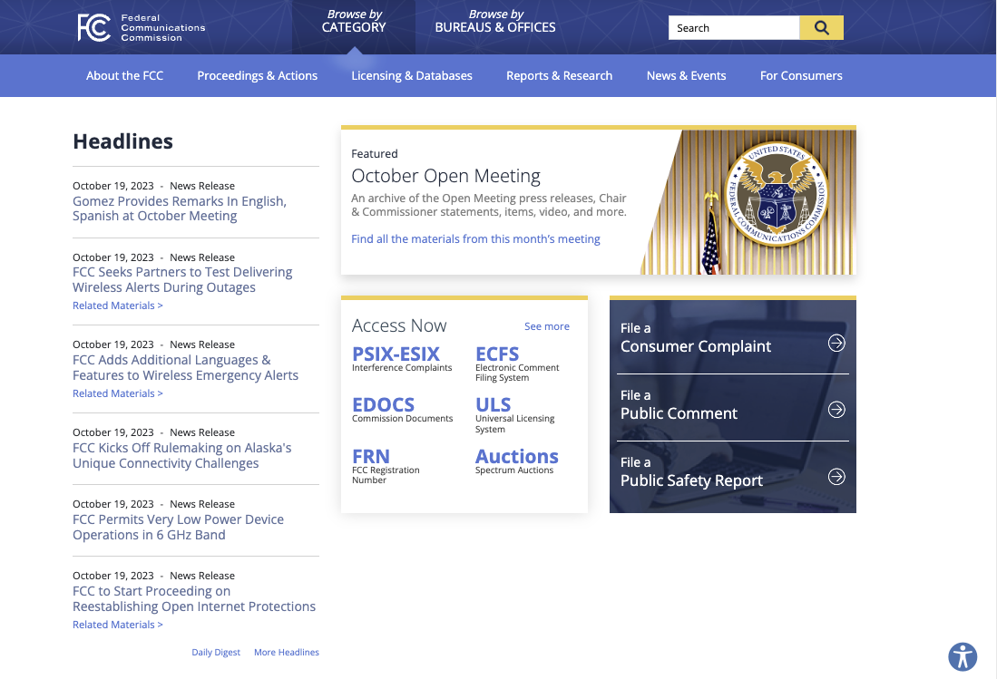

Website Chosen
Federal Communications Commission
https://www.fcc.gov/

Slide 5
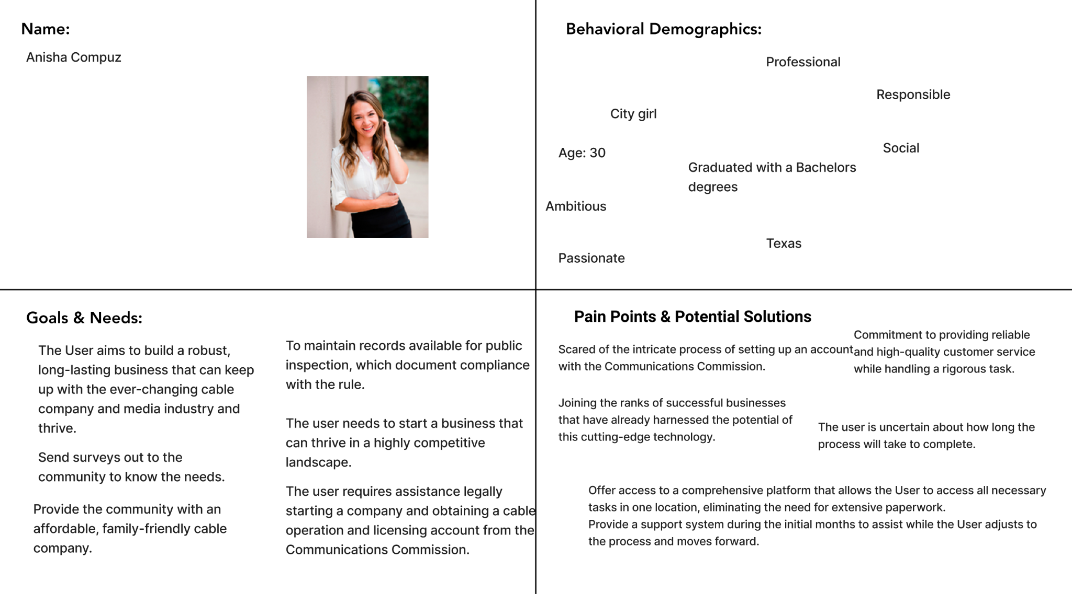
Proto Persona
https://www.figma.com/file/7VD2X69Hmq3awkn0oUNyW3/Proto-Persona---Govt.-Website?type=whiteboard&node-id=0%3A1&t=yVzzUeQy8jiycdyr-1

Slide 6
User Scenario
The individual is seeking a transition from their current role as an editor to becoming the proprietor of a cable company. The user needs more options available from traditional cable providers. As more and more friends and family express frustration with the mounting expenses associated with additional packages and entertainment subscriptions, the individual has decided to take matters into their own hands. To that end, they have obtained the Franchise agreement and seek guidance on setting up an account with the Federal Communication Commission to begin the process.

Slide 7
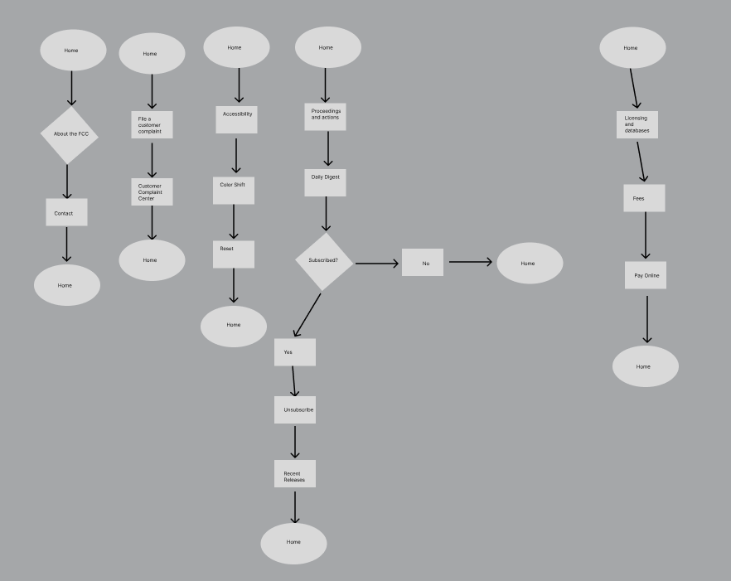
User Path
https://www.figma.com/file/jEHJASdRxlNmcrClsxJWEj/Userpath_GovernmentAgency?type=design&node-id=0%3A1&mode=design&t=PtaTWR7aQ1cHO3kW-1

Slide 8
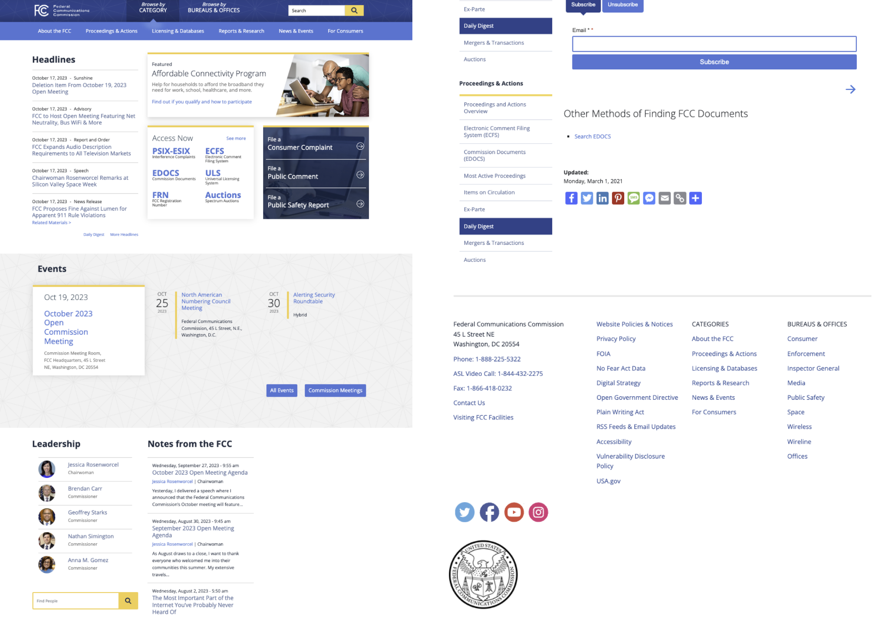
Government Agency screenshot
https://www.figma.com/file/1TNIyWG23ZeenJbPy3oLmA/Screenshots-of-govt-agency?type=design&node-id=1%3A3&mode=design&t=es3e2ZTQQ4hwlvaS-1

Slide 9
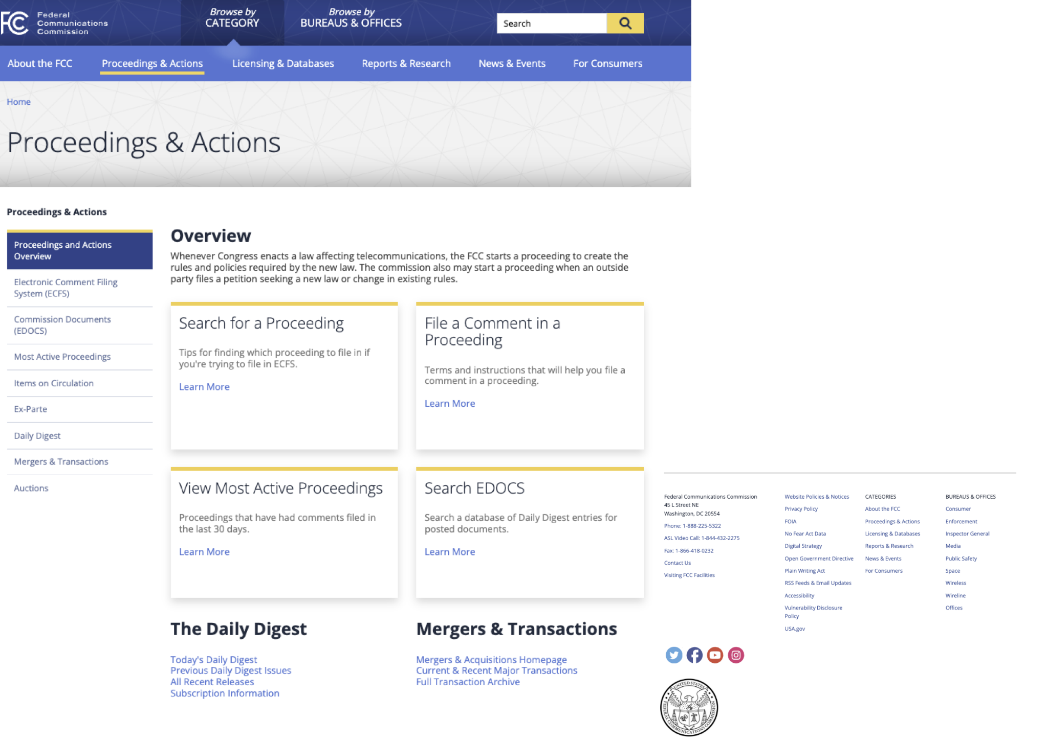
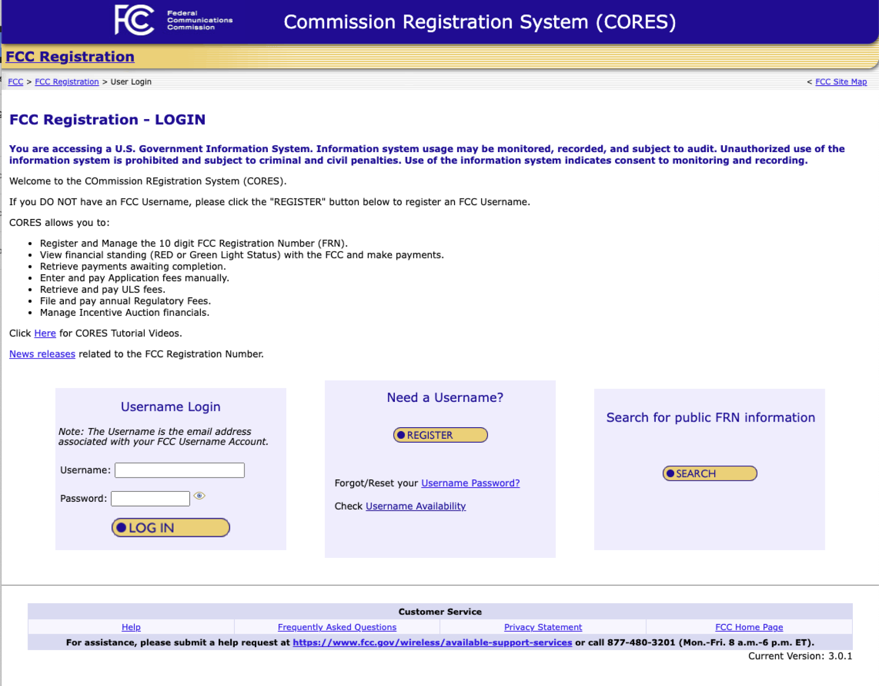
Wireflows
https://www.figma.com/file/HI3CFSUkwCaDajRoUzbJYW/Wireframes?type=design&node-id=0%3A1&mode=design&t=tKZBfiqGUplZw2DU-1

Slide 10
Heuristic Evaluation
Link to heuristic evaluation: https://docs.google.com/spreadsheets/d/1QnHVocsptplTf8m_QgmpTlvcvhe51iac2leeibJpw1Y/edit?usp=sharing
Link to Government Website Screenshots:
https://www.figma.com/file/1TNIyWG23ZeenJbPy3oLmA/Screenshots-of-govt-agency?type=design&node-id=0%3A1&mode=design&t=UgqSBQtxiTsRryLP-1
Link to Government Website Wireflows: https://www.figma.com/file/HI3CFSUkwCaDajRoUzbJYW/Wireframes?type=design&node-id=0%3A1&mode=design&t=JeJQGvPuY1ITw6bD-1

Slide 11
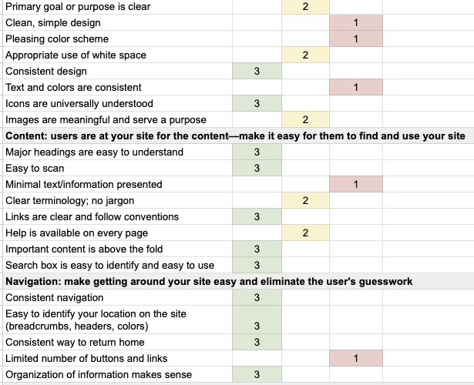
Heuristic Analysis
Link to heuristic evaluation screenshots: https://www.figma.com/file/z7o20PspQhAYTyu3Cre5gU/Usability-%26-Heuristic-Evaluation--Screenshots?type=design&node-id=0%3A1&mode=design&t=MkZFWz4j7O2cdaWR-1
Link to heuristic evaluation:
https://docs.google.com/spreadsheets/d/1QnHVocsptplTf8m_QgmpTlvcvhe51iac2leeibJpw1Y/edit?usp=sharing

Slide 12
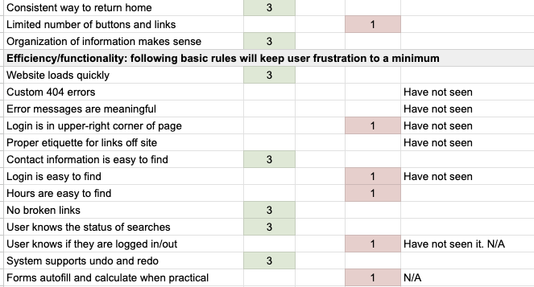
Link to heuristic evaluation:https://docs.google.com/spreadsheets/d/1QnHVocsptplTf8m_QgmpTlvcvhe51iac2leeibJpw1Y/edit?usp=sharing
Link to heuristic evaluation screenshots: https://www.figma.com/file/z7o20PspQhAYTyu3Cre5gU/Usability-%26-Heuristic-Evaluation--Screenshots?type=design&node-id=0%3A1&mode=design&t=MkZFWz4j7O2cdaWR-1

Slide 13
Usability Test Interview
Link to User Testing Notes: https://docs.google.com/document/d/1IZV54_v2tnY0Y22zr6wRaIFfYeU2pGaUzc-796GhhLk/edit?usp=sharing
Link to Recordings:
https://docs.google.com/document/d/1z-K1d6VXXnkQNoIljPoDf1sdqBbtitJNmWc9N2b4M7s/edit?usp=sharing
Review guerrilla testing: miro board to capture the analysis:
https://miro.com/welcomeonboard/clN3TXI5WXkyVGk2OGxUQ2JZaWlMRTBsWE5iR3VSYjlsOXcyOE5vaDhpN0NET2cxYlZNNVUxZFNOY3pyVm9WZHwzNDU4NzY0NTYxMzg4OTI5MTE5fDI=?share_link_id=875193821806

Slide 14
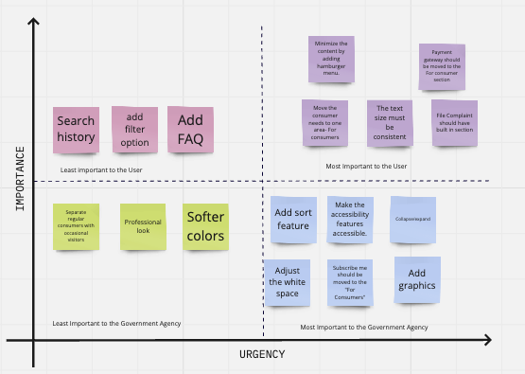
Prioritization: 2X2 Matrix
https://miro.com/welcomeonboard/d29SZ2NYVGZBOVRCUkZxTXF0SVJlRk1XNkhyZU9GOG9udEc1Z2d2ZDNSdU1ueDVZQU8zQnRBMGFtN3h2Z1NaeHwzNDU4NzY0NTYxMzg4OTI5MTE5fDI=?share_link_id=32173598470

Slide 15
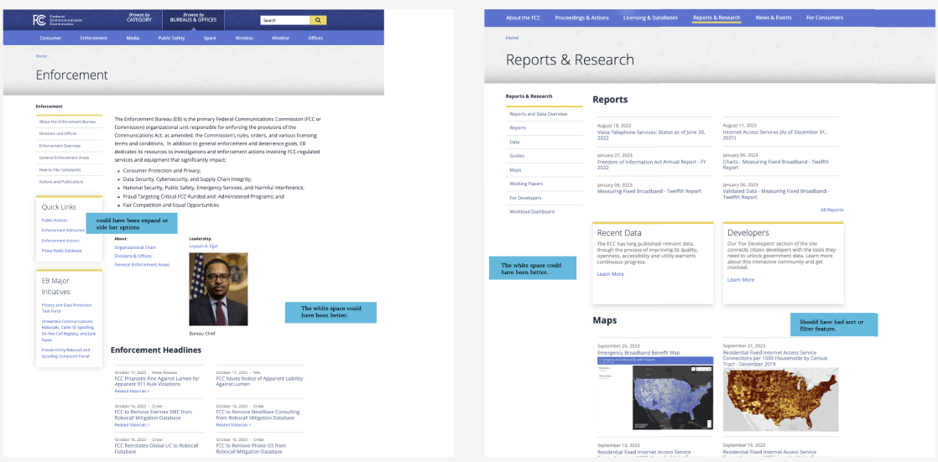
https://www.figma.com/file/1TNIyWG23ZeenJbPy3oLmA/Screenshots-of-govt-agency?type=design&node-id=1%3A3&mode=design&t=es3e2ZTQQ4hwlvaS-1

Slide 16
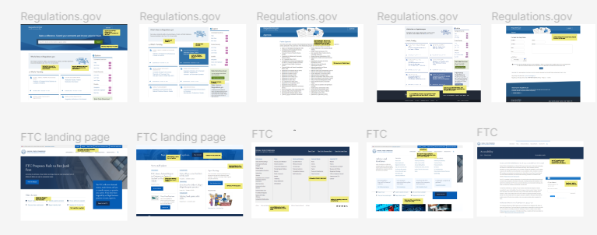
Webpage Screenshots- Annotations
Link to Government Agency Screenshots: https://www.figma.com/file/z7o20PspQhAYTyu3Cre5gU/Usability-%26-Heuristic-Evaluation--Govt.-Agency-Screenshots?type=design&node-id=0%3A1&mode=design&t=AUAZIjNi0fMXZC8Z-1
Link to additional web page Screenshots:
https://www.figma.com/file/oTpnqdtLLU5rIhJBqV9L2G/usability-and-heuristics-issues-for-five-web-pages?type=design&mode=design&t=L5FIHgEC2IYVCJCm-1

Slide 17
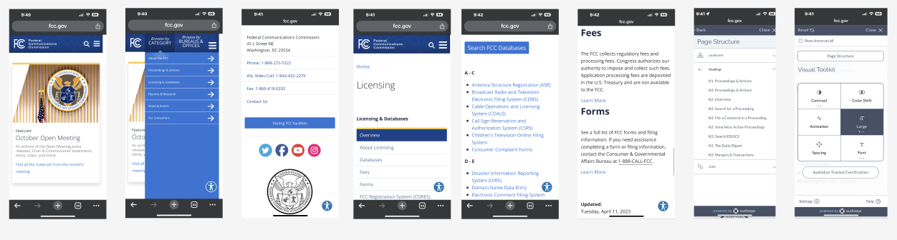
Mobile View
https://www.figma.com/file/j0gQ9EjCx8YE9YTyJDd7tI/Mobile-View-Heuristic-Evaluation?type=design&node-id=0%3A1&mode=design&t=PbjrORIrYfUBNjuD-1

Slide 18

Moodboard
https://www.figma.com/file/P7upAmj1OncV118GRj2nJx/UI-Patterns_UI-Samples-%26-Inspiration?type=design&node-id=1%3A29&mode=design&t=INKtSO8UhVOJK5wP-1

Slide 19
Information Architecture
Aruna Andrew
Homework 09

Slide 20
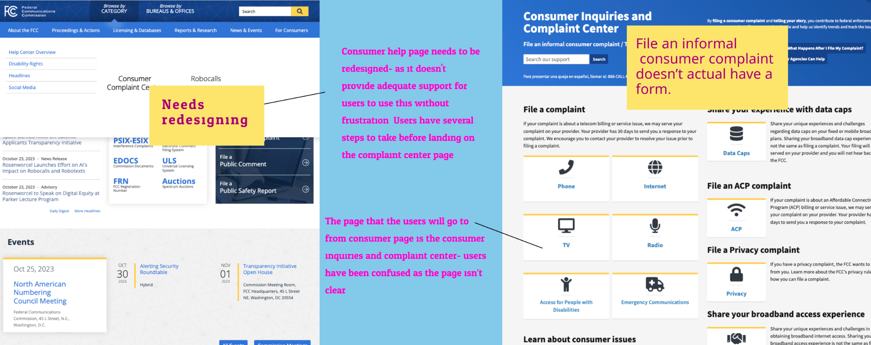
Annotated Agency navigation
Figma Link
Google Drive

Slide 21
Notes from Usability website navigation tests
Links to the usability testing recordings: Google Drive
Links to view the recordings: Google Drive
Link for usability test finding analysis: Miro Link for identifying major points.
Link for prioritization results: Miro

Slide 22
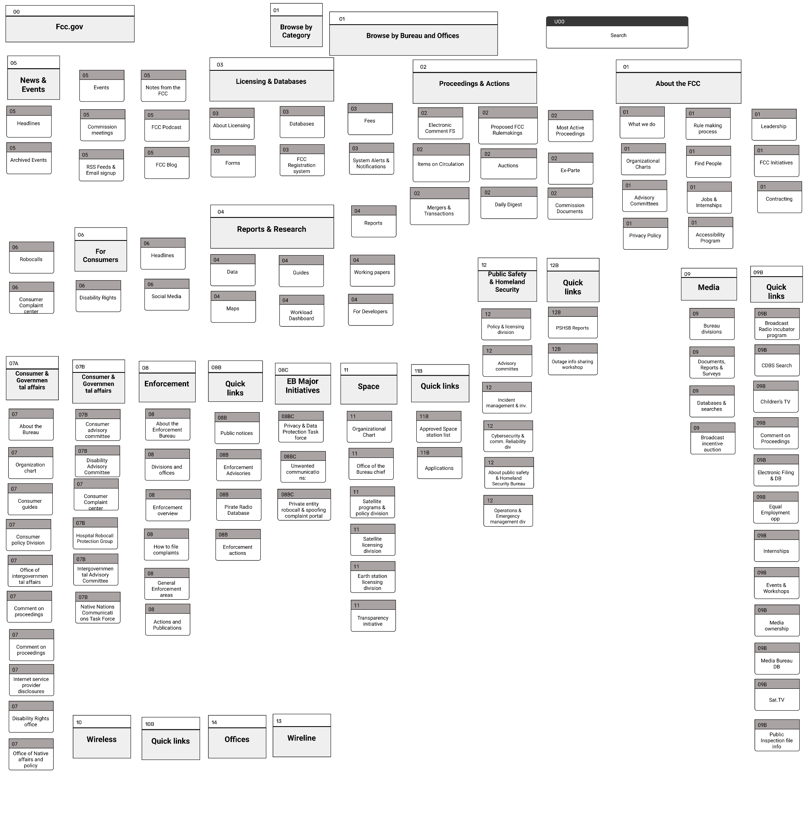
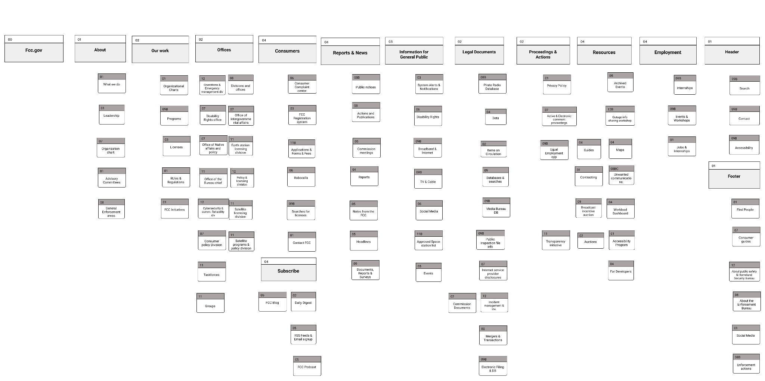
Card Sorting Results photo
Card Sorting on Government Agency Website
Figma link
Google Drive link

Slide 23
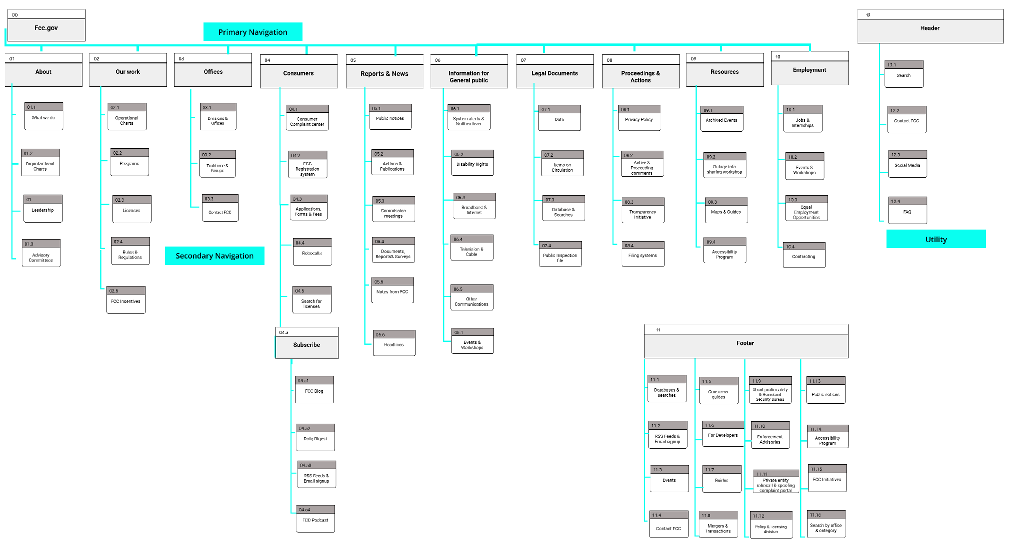
New sitemap image+link to Figma file.
Figma Link
Google Drive Link

Slide 24
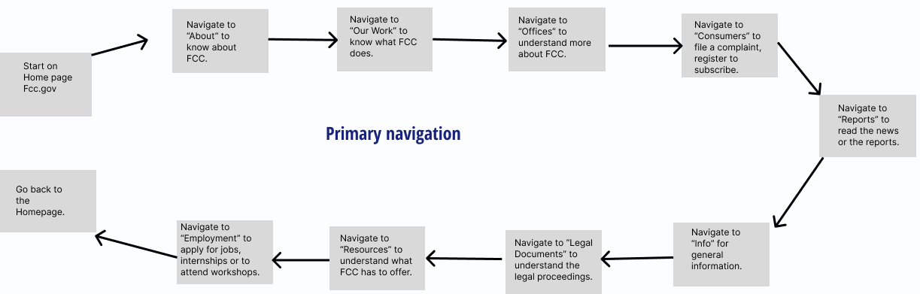
Primary Navigation
Figma File

Slide 25
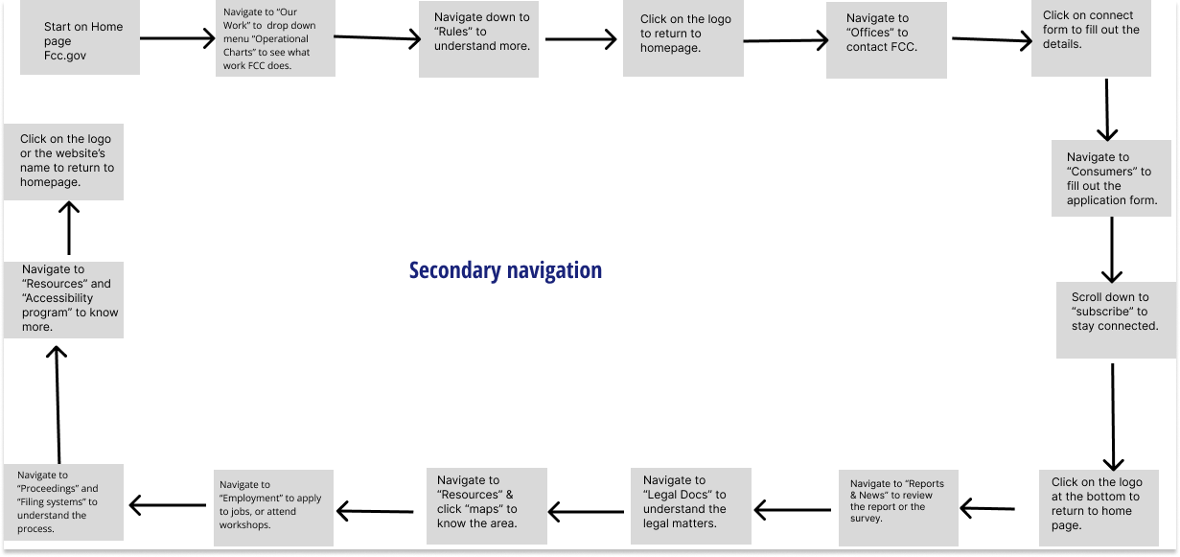
Secondary Navigation
Figma File

Slide 26
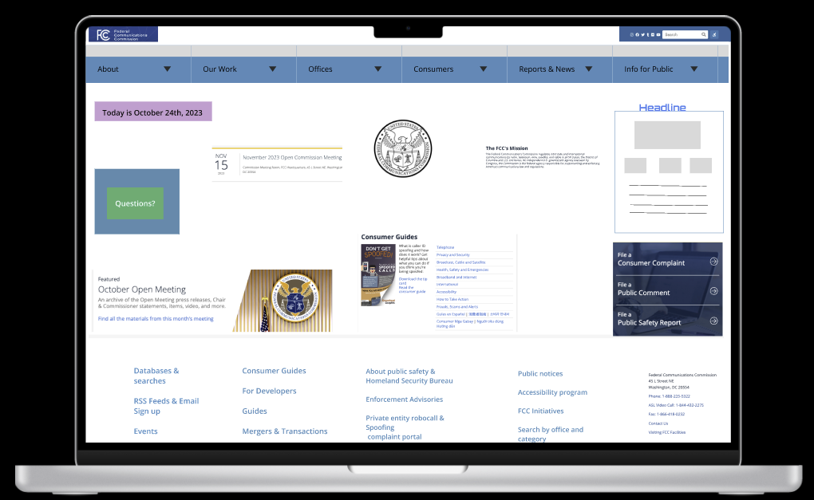
Figma link
Google Drive
Link

Slide 27
Homepage UI Design and Testing
Aruna Andrew
Homework 10

Slide 28
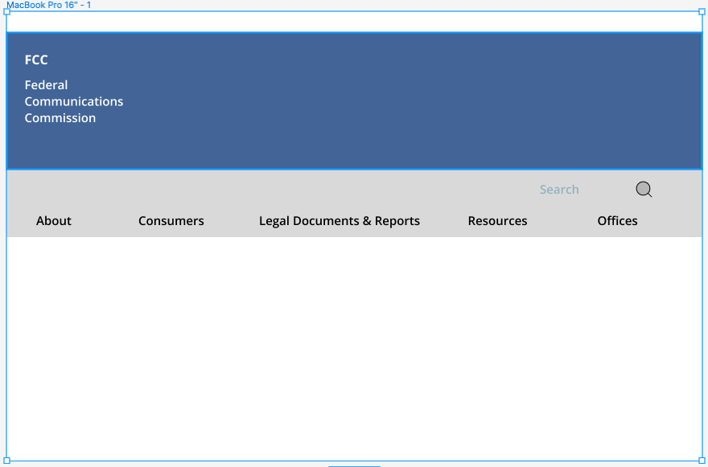
Government Agency
Desktop Header Wireframe
Desktop Header Wireframe

Slide 29
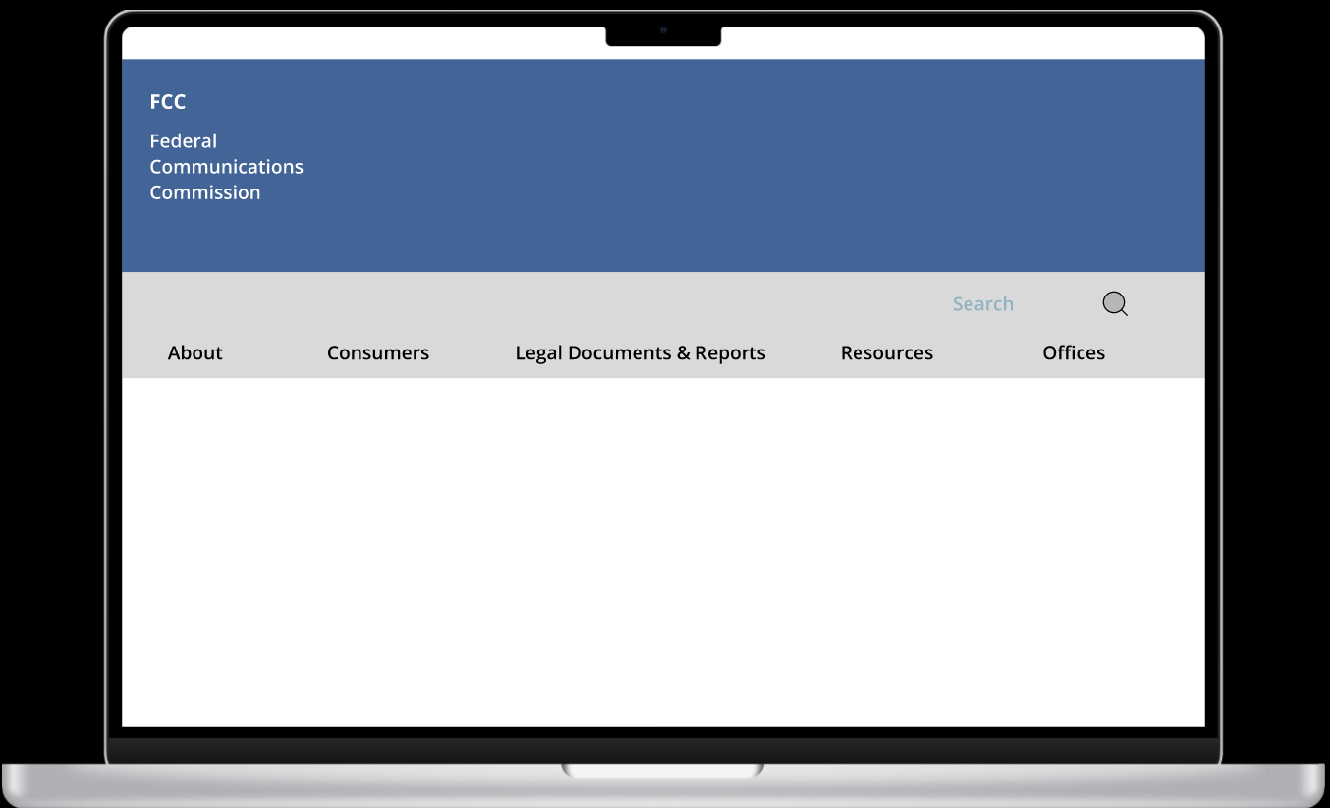
Desktop
Header
Prototype
Desktop Header prototype

Slide 30
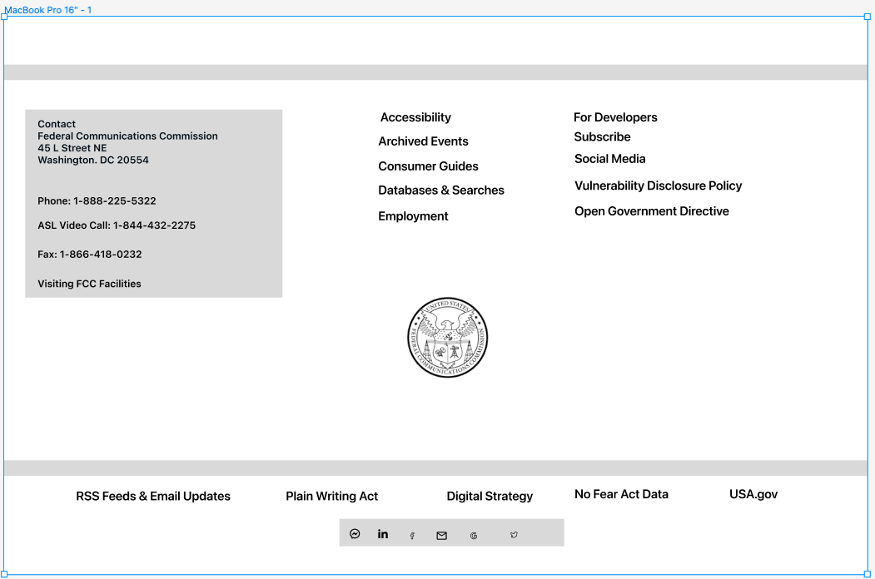
Desktop
Footer Wireframe
Desktop Footer Wireframe

Slide 31
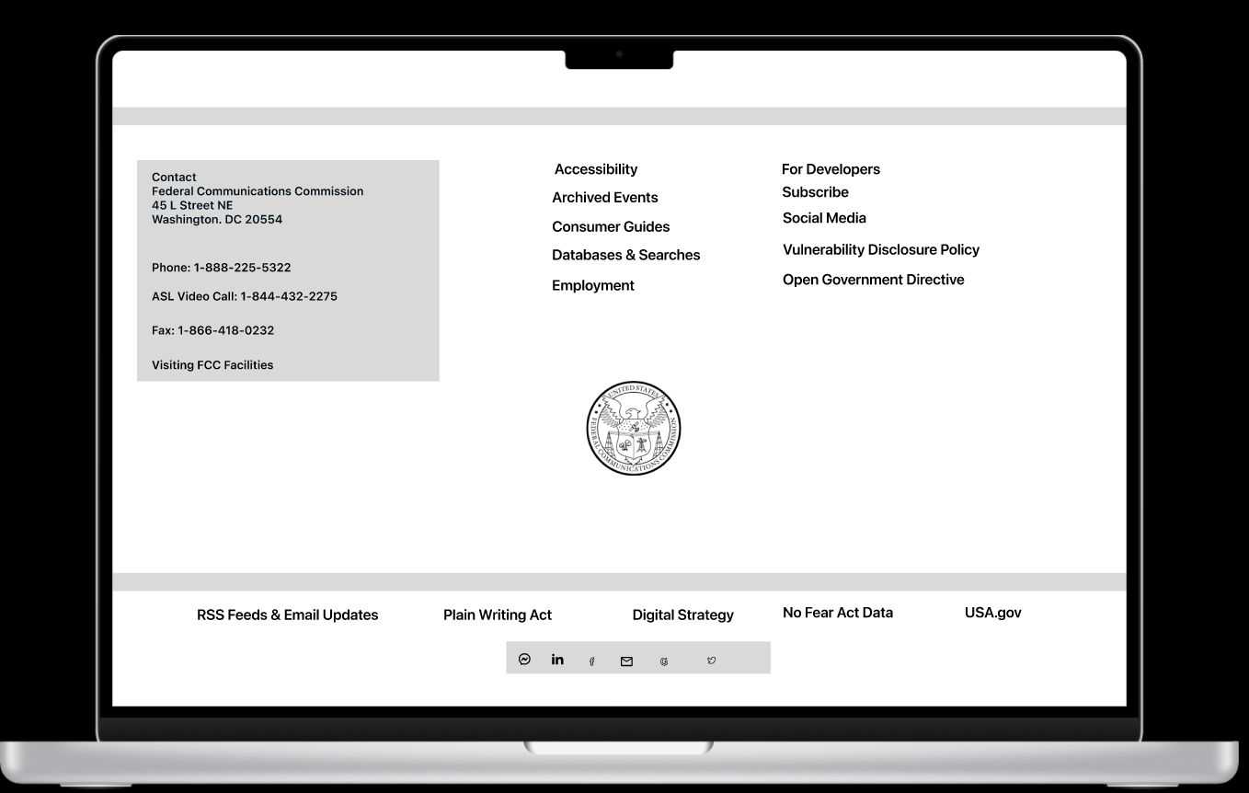
Desktop
Footer
Prototype
Desktop Footer Prototype

Slide 32
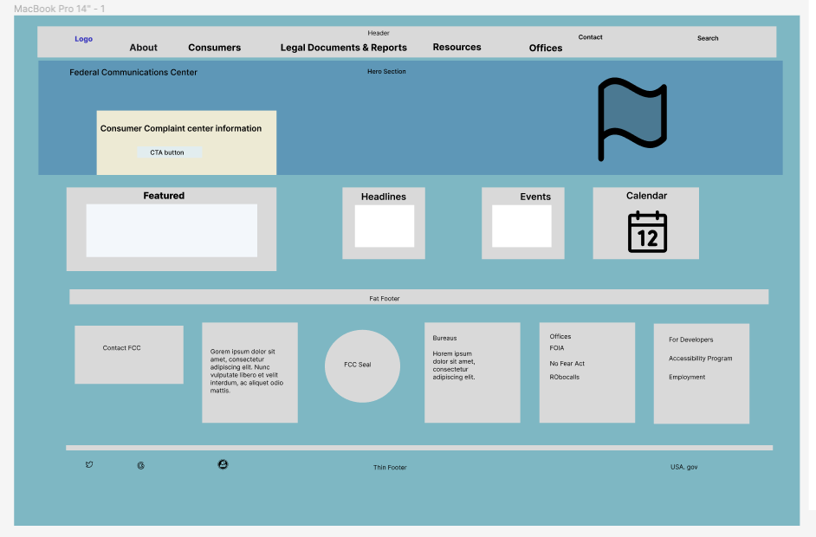
Desktop
Homepage
Wireframe
Homepage Wireframe

Slide 33
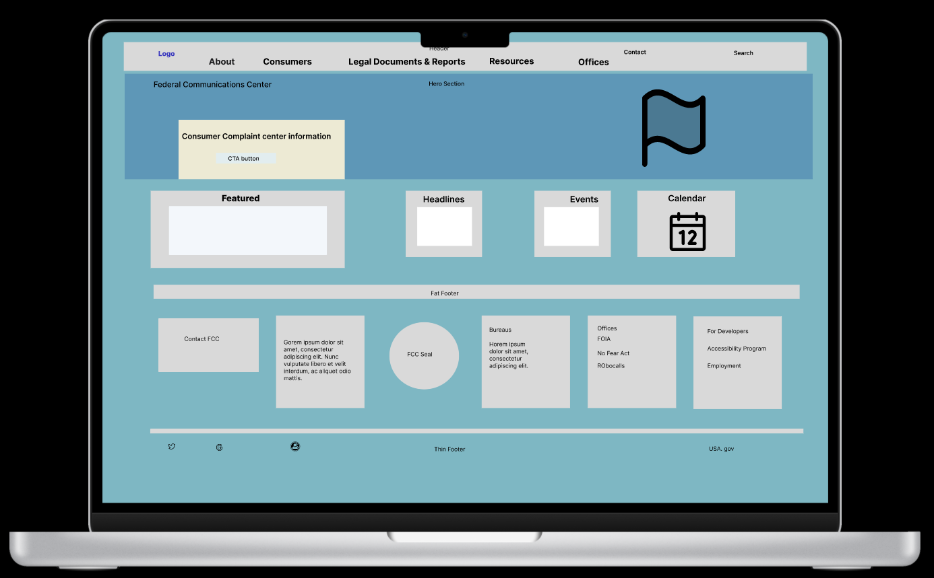
Desktop
Homepage
Desktop Homepage prototype

Slide 34
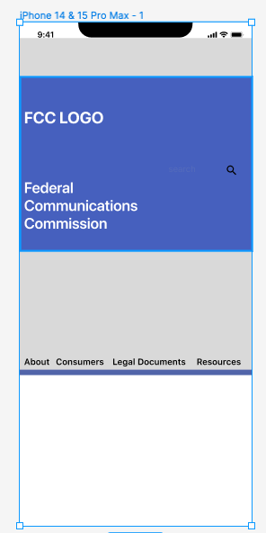
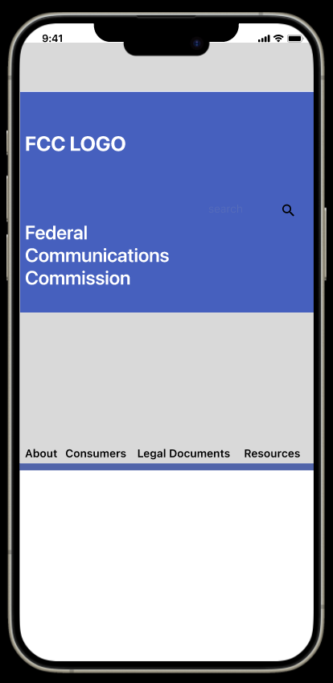
Mobile Header
Mobile Header Wireframe
Mobile Header prototype

Slide 35
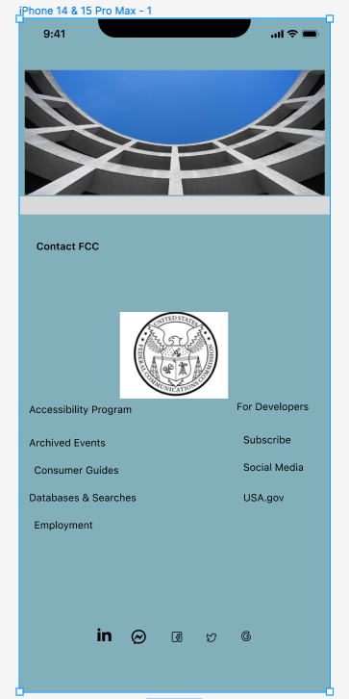
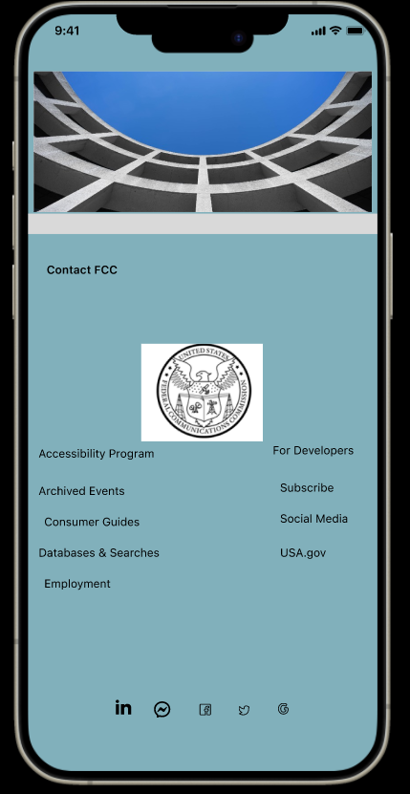
Mobile Footer
Mobile Footer prototype
Mobile Footer Wireframe

Slide 36
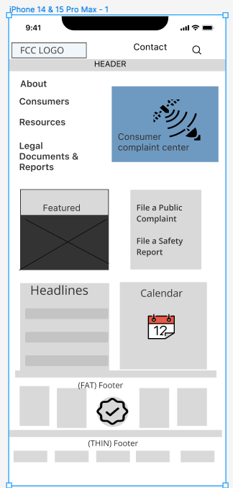
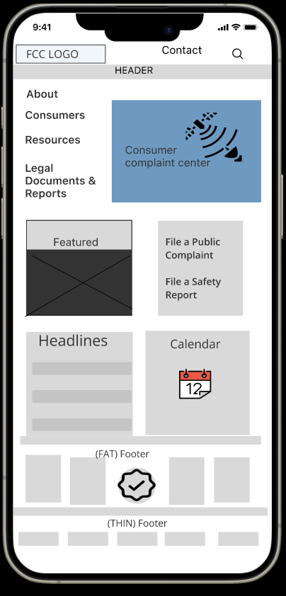
Mobile Homepage
Mobile Homepage Prototype Wireframe
Mobile Homepage Wireframe

Slide 37
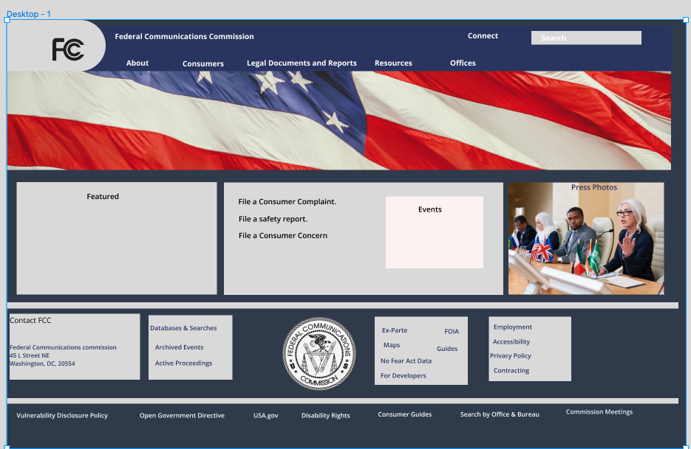
Desktop Homepage Redesign
Desktop Homepage Redesign

Slide 38
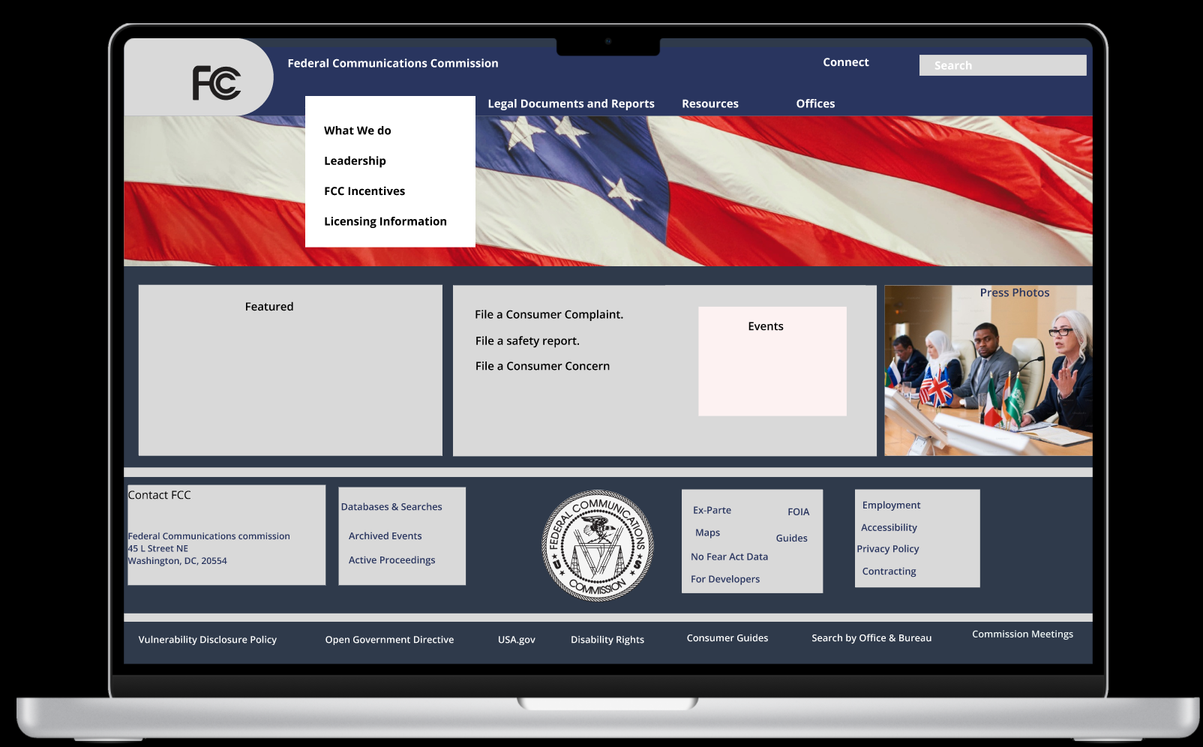
Navigation Redesign

Slide 39
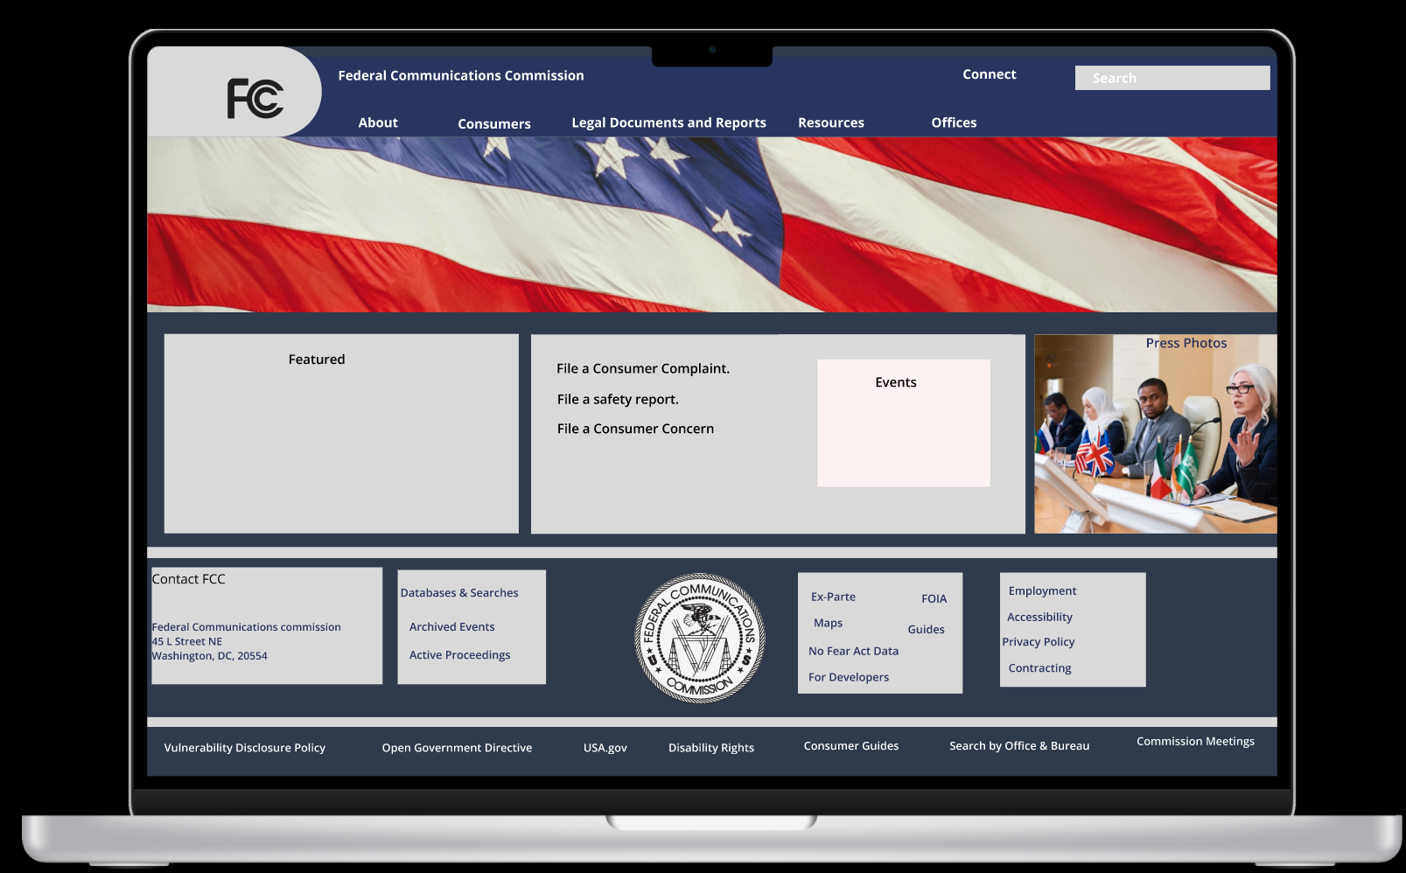
Desktop Redesign navigation prototype

Slide 40
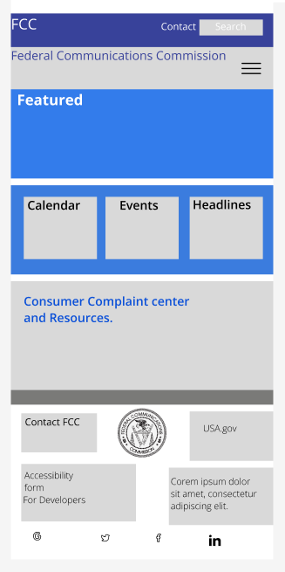
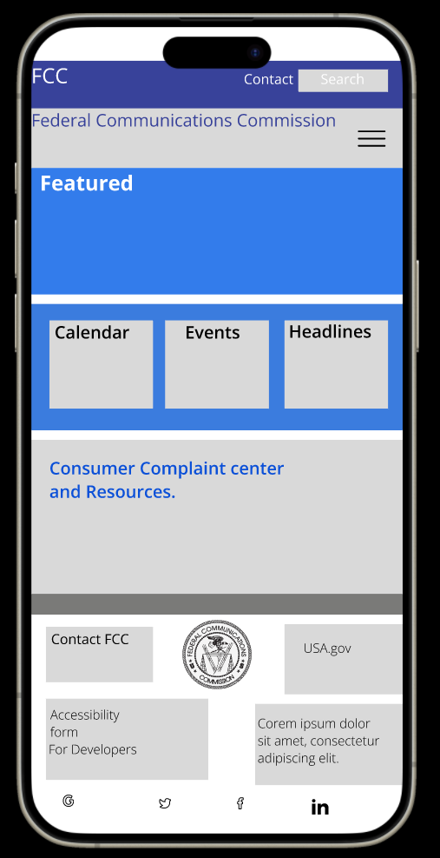
Mobile Homepage Redesign Prototype
Mobile Homepage Redesign

Slide 41
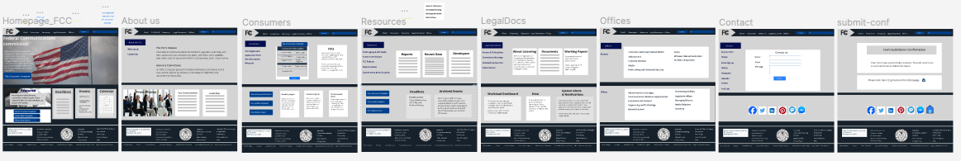
Clickable Prototype link for the Re-Redesign
New Design clickable prototype link
Google Doc with a clickable prototype link

Slide 42
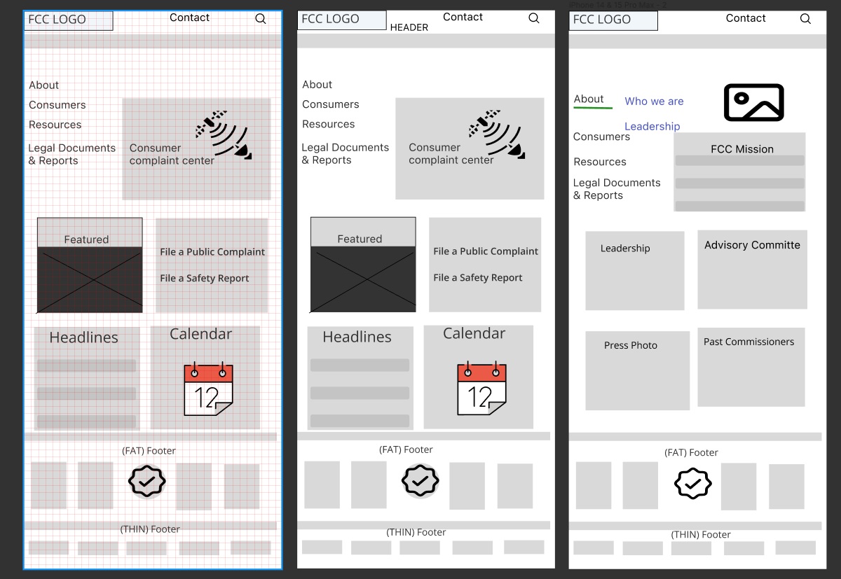

Slide 43
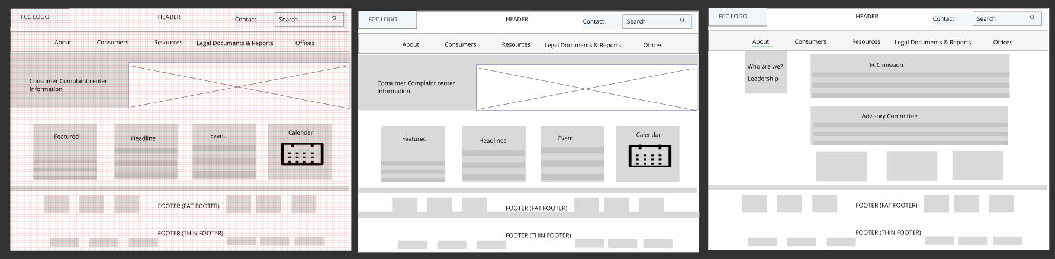
Figma Link to Website Grid and Wireframe

Slide 44
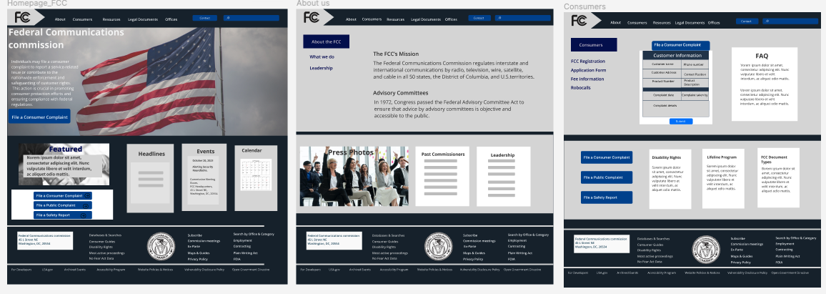
Clickable Prototype
Figma Link
Clickable Prototype

Slide 45
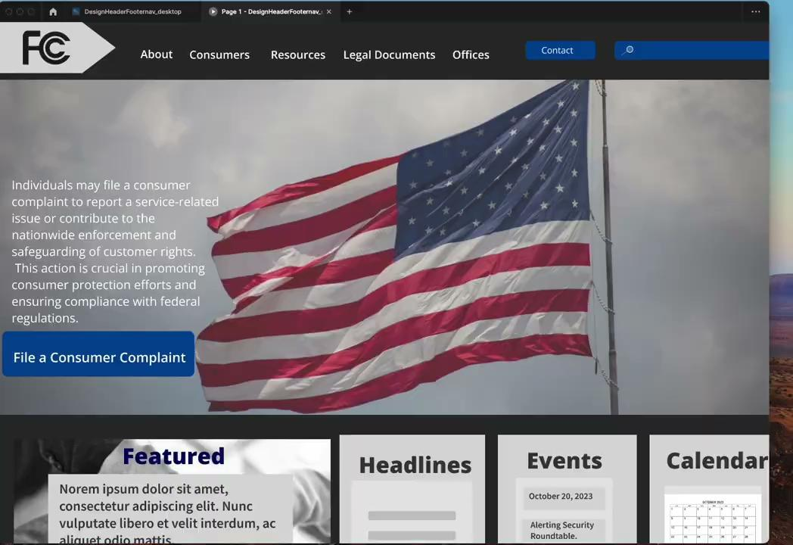
Additional Recordings

Slide 46

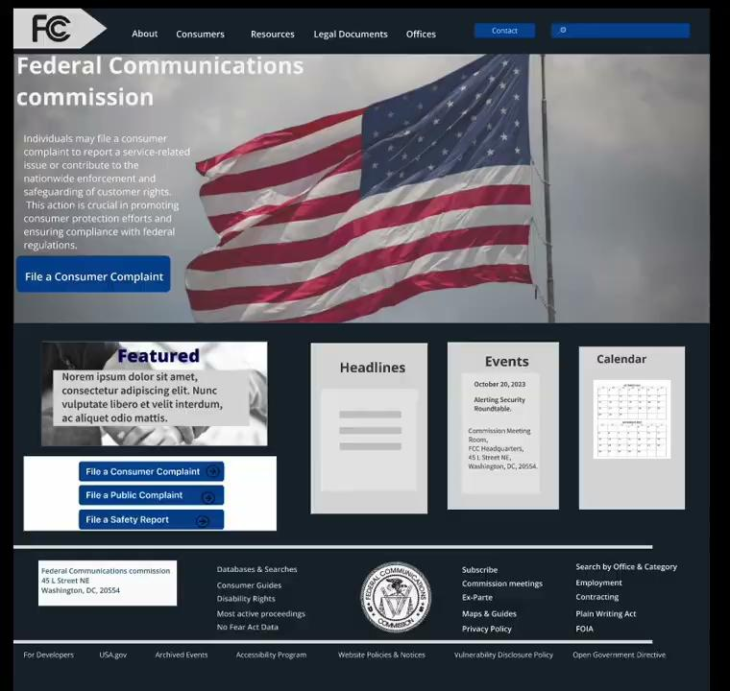
Screen Recording of Testing
Additional Recordings
Clickable Prototype
Five-second usability test link

Slide 47
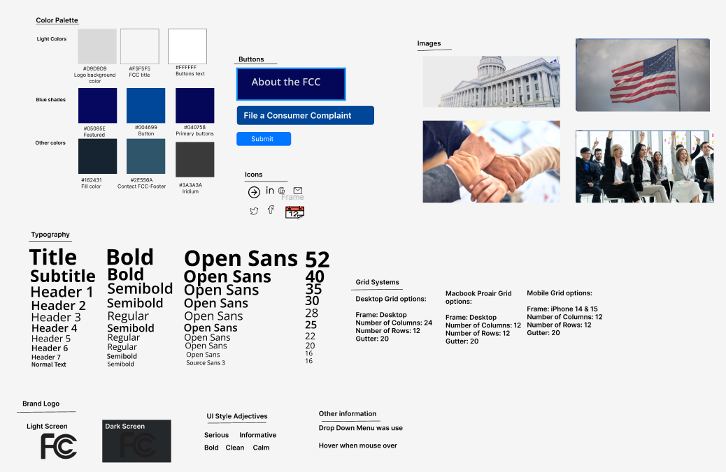
UI Style Guidelines- Figma link

Slide 48
Responsive Design
Aruna Andrew
Homework 11

Slide 49
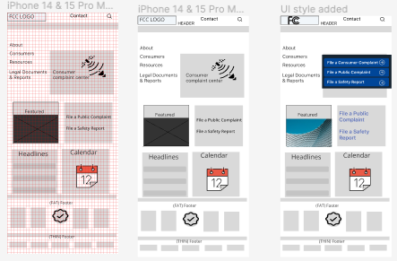
Mobile Wireframe

Slide 50
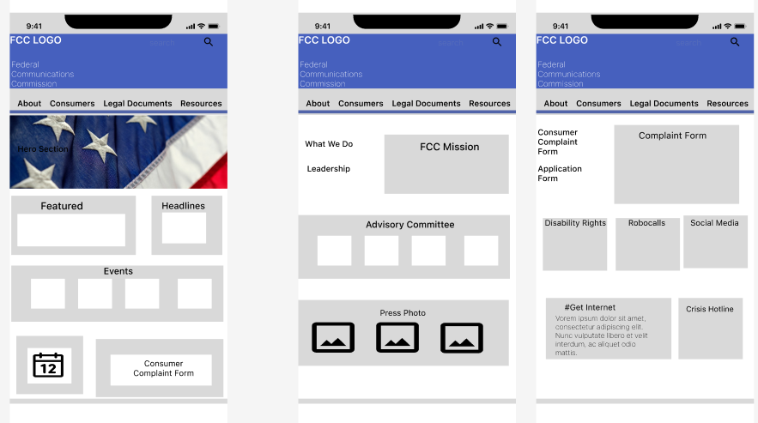
Mobile Wireframe

Slide 51
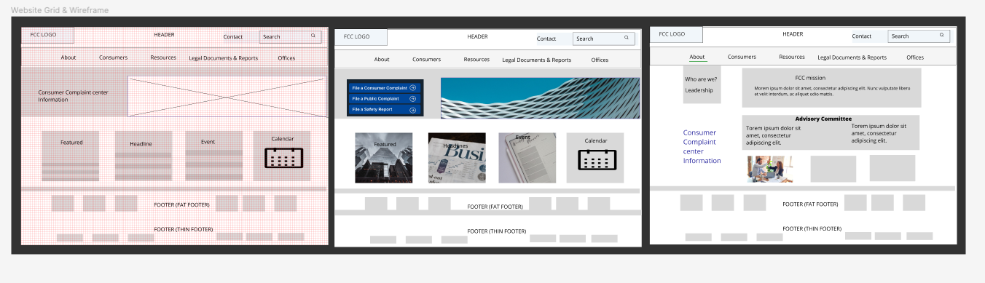
Desktop Wireframes

Slide 52
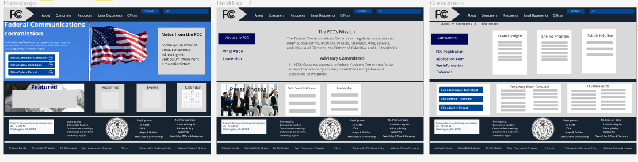
Desktop Wireframes

Slide 53
Interaction Design
Aruna Andrew
Homework 12

Slide 54
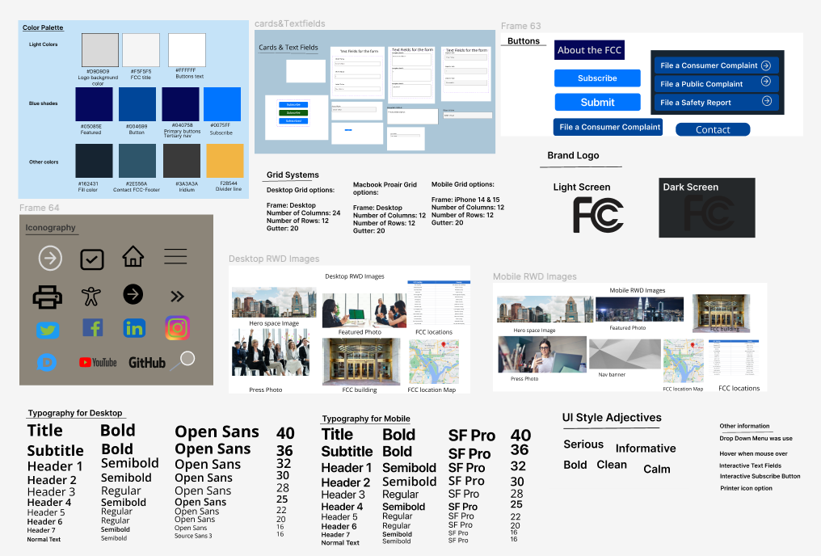
UI Style guide
Google Drive Link

Slide 55
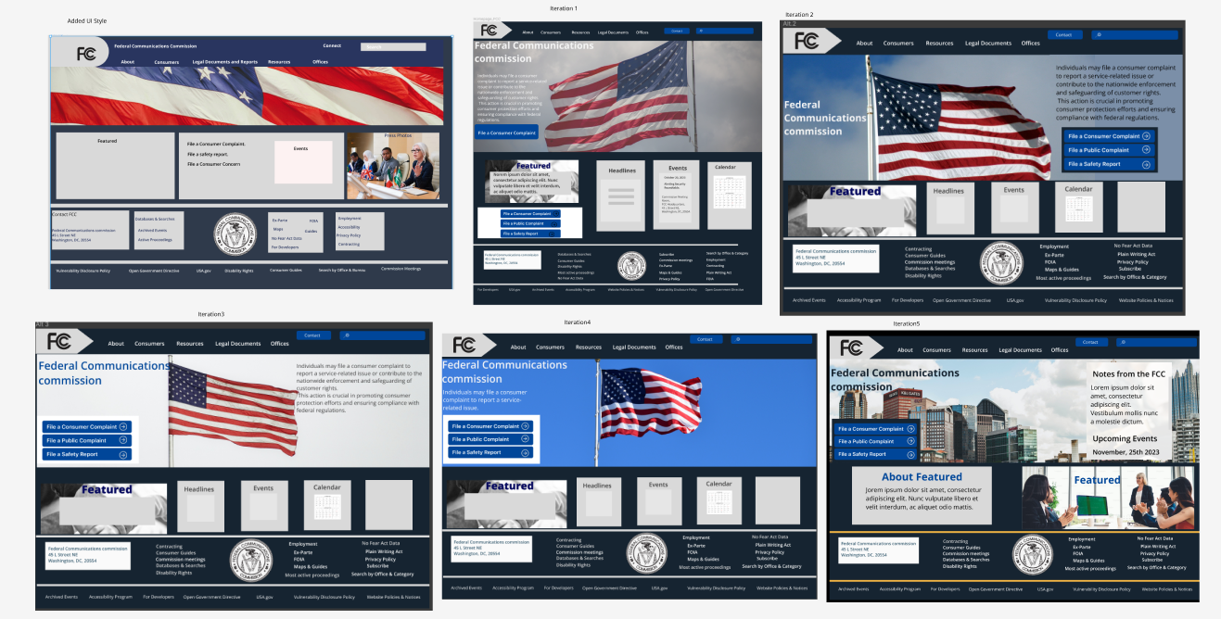

Create & Iterate Desktop Homepage wireframes

Slide 56

Screen Recording

Slide 57


Create & Iterate Mobile Homepage wireframes

Slide 58
Screen Recording: Mobile

Slide 59

Responsive Desktop Homepage
Figma Link

Slide 60

Responsive Desktop Homepage
Figma Link

Slide 61


Responsive Mobile Homepage
Figma Link

Slide 62

Responsive Mobile Homepage
Figma Link

Slide 63

Comparison

Slide 64

Comparison

Slide 65

Comparison

Slide 66

Comparison-mobile

Slide 67

Redesigned Additional Desktop Pages

Slide 68

Redesigned Additional Desktop Pages

Slide 69


Redesigned Additional Mobile Pages

Slide 70
Usability Testing
Notes on Google Drive
Link to the Recordings

Slide 71

Usability testing
Responses captured to identify pain points: Figma Link

Slide 72

Figma Link

Slide 73


High-fidelity tablet version.

